Slide 1
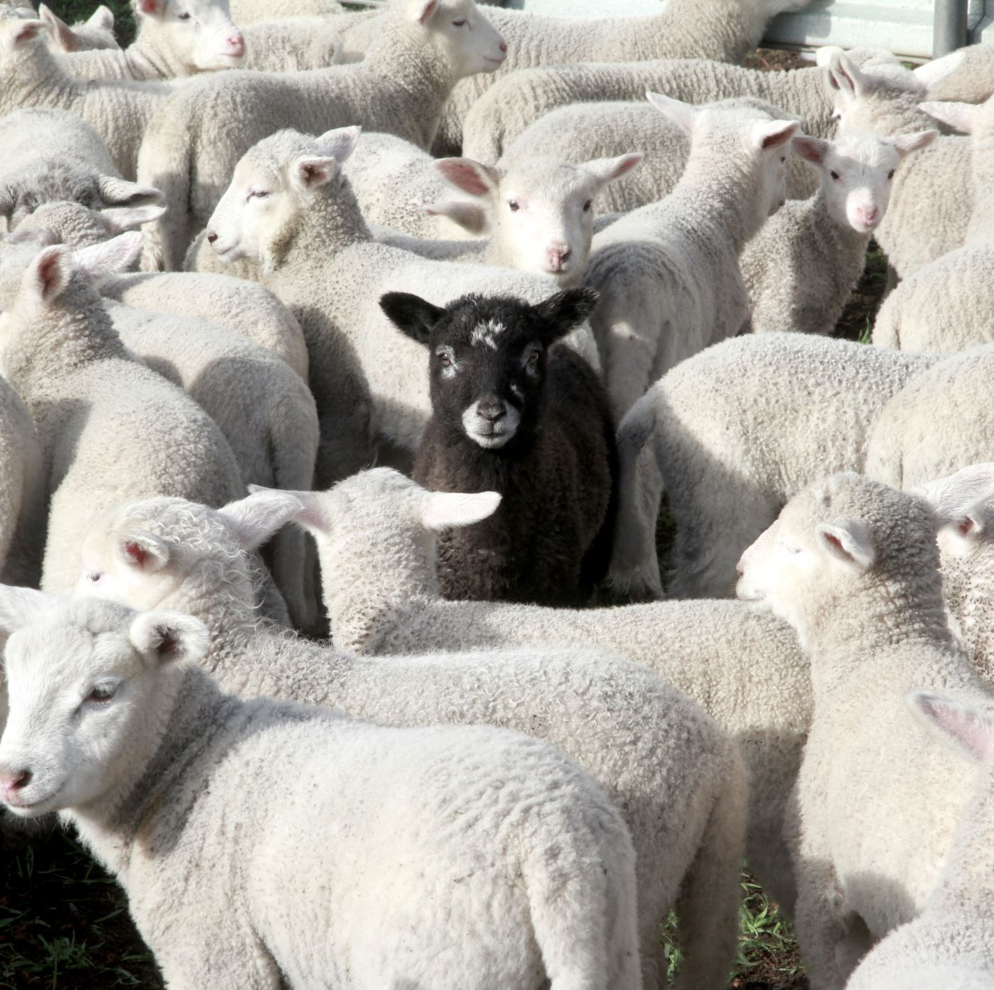
Montgomery County Office of Animal Services Data Analytics Dashboard - Project Report
By Merveille Lore Kuendzong
DATA 205 CRN: 22017
12/18/2024

Slide 2
Introduction
Goal
Analyze and visualize trends in animal intake, fostering, and adoption to inform the public and reduce unnecessary calls regarding animal services. The analysis may prompt OAS to adjust some procedures based on the data insights

Slide 3
Introduction
Data:
Data source: Office of Animal Services (OAS) of Montgomery County
Datasets:
OAS-Kennel: Main dataset with details about animals in the shelter.
OAS-Foster: Information on animals that were placed in foster care.
OAS-Impound: Records of animals that were impounded.
OAS-Treatments: Details of medical procedures and treatments given to animals.

Slide 4
Introduction
Tools
R programming: For data cleaning, processing, and analysis.
Packages:
lubridate: For handling date-time data, such as calculating durations and extracting date components.
tidyverse: A collection of R packages (including ggplot2 and dplyr) that facilitated data manipulation, visualization, and analysis.
plotly: For creating interactive, web-based visualizations, allowing users to explore the data more dynamically.
vcd: For visualizing and analyzing categorical data.
DescTools: For specific statistical analysis.
Tableau: To create interactive visualizations and the final dashboard.
Methods
Descriptive analysis (Counts, summary, unique values… etc)
Regression analysis (Linear regression model to predict time in the shelter)
ANOVA Test
T-tests
Chi-squared tests
Correlation analysis (Cramér’s V Test)

Slide 5
Summary of Data Pre-processing
Overview of Data Pre-processing
Focus on Kennel Dataset
Core dataset for statistical analysis, integrating foster and impound activities.
Treatment dataset excluded due to time constraints.
Data Filtering
Excluded records with:
Outcome types: 'lost exp', 'find exp'.
Kennel types: 'lost', 'found'.
Intake types: 'disposal' and conditions labeled 'dead'.
Outcome type: 'disposal' (administrative use).
Animal type: 'wildlife’ (Before computing adoption rates).

Slide 6
Summary of Data Pre-processing
Data Transformation
New Variables Created
adopted: Binary indicator for adoption status.
time_in_shelter: Duration in days between intake and outcome dates.
intake_season: Categorized entries into seasons (e.g., fall, spring).
Handling Missing Data
Removed records with missing shelter time for consistency.
Date Formatting
Reformatted intake and outcome dates using the lubridate package for accuracy.

Slide 7
Basic Descriptive Statistics
Dataset Overview
Total Records: 56,881 (Jan 1, 2018 – Sep 11, 2024) before cleaning and filtering.
Key Variables:
Animal Type: Bird (2,473), Cat (17,199), Dog (13,464), Livestock (138), Other (5,941), Wildlife (3,127).
Intake Types: Boarding (792), Confiscate (1,561), Euthanasia Requested (1,501), Foster (6,150), Owner Surrender (9005), Return (718), Stray (15,009), Transfer (128), Veterinary (128), Wildlife (7122).
Outcome Types: Adoption (14,075), Died (997), Euthanasia (7,568), Foster (6,268), Missing (8), Null (191), Relocate (165), Return to Owner (6,093), Transfer (6,977).
Adopted Status: Not Adopted (28,267), Adopted (14,075).
Other Key Variables: Intake/Outcome Dates, intake season (calculated), Time in Shelter (calculated).

Slide 8
Final data product
A dashboard with the following tabs
The Home tab serves as the landing page and provides navigation buttons to access the other sections.
The Shelter Pathways tab illustrates the various pathways animals take through the shelter system.
The Impound Pathway tab shows the flow from animal intake through impound and onward to potential outcomes.
The Animal Intake tab presents the different intake types of animals and explains the intake process.
The Community Partners tab details partnerships involving foster homes and rescue organizations for each year.
The Live Release Rates tab displays metrics related to live and non-alive outcomes.
The Animal Outcomes tab provides insights into all possible outcomes for animals, including adoption, euthanasia, and transfer.
The Animal Wellness tab focuses on metrics related to the health, care, and well-being of animals in the shelter system.
The Glossary of Terms button leads to a dedicated glossary page, explaining key terms used throughout the dashboard.

Slide 9
Analysis

Slide 10
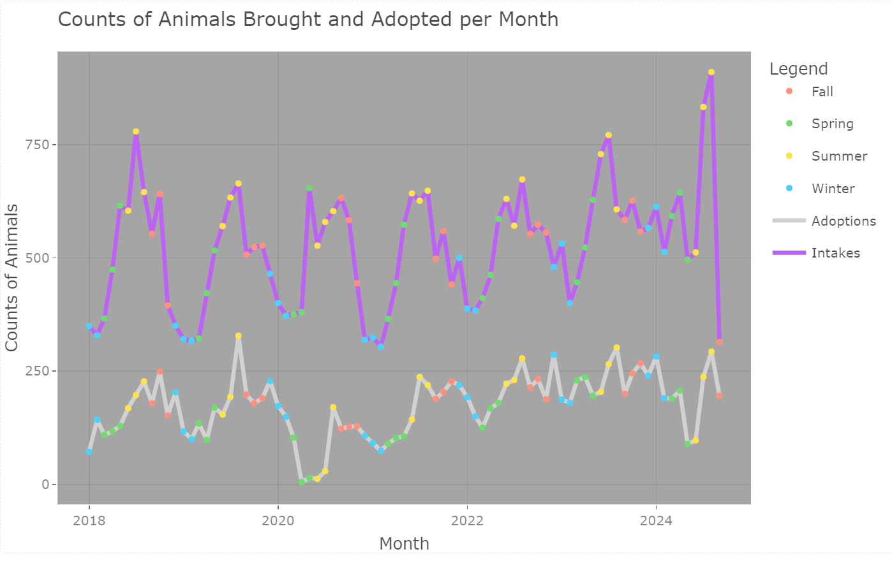
Intake and Adoption Trends Over Months

Slide 11
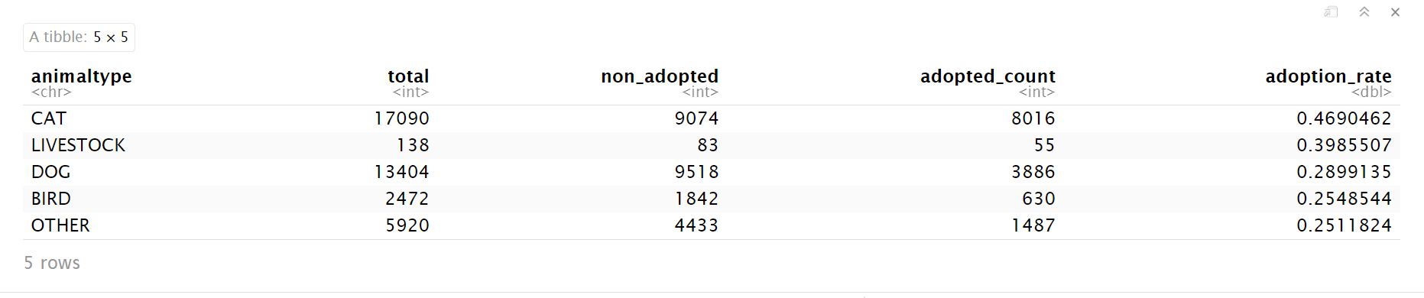
Adoption Rates

Slide 12
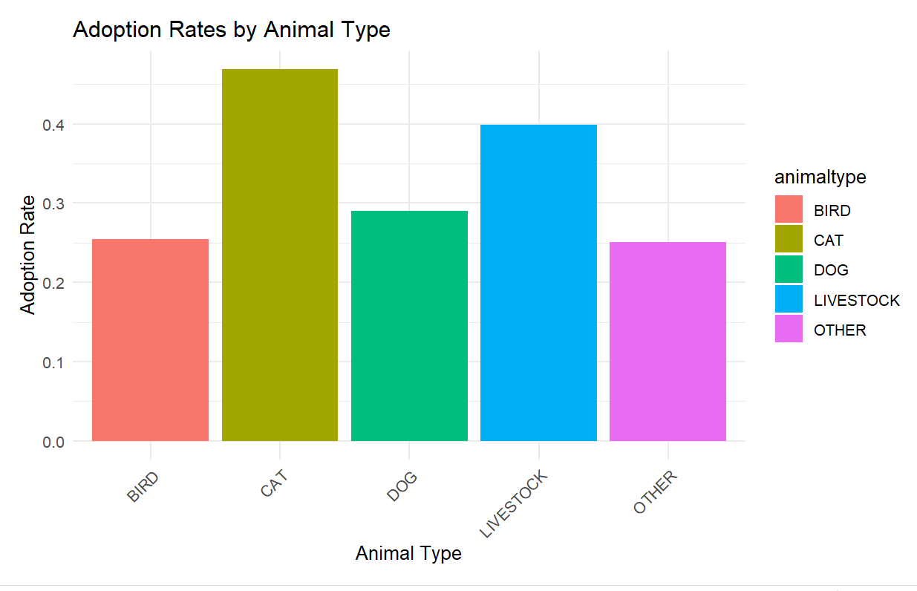
Adoption Rates

Slide 13
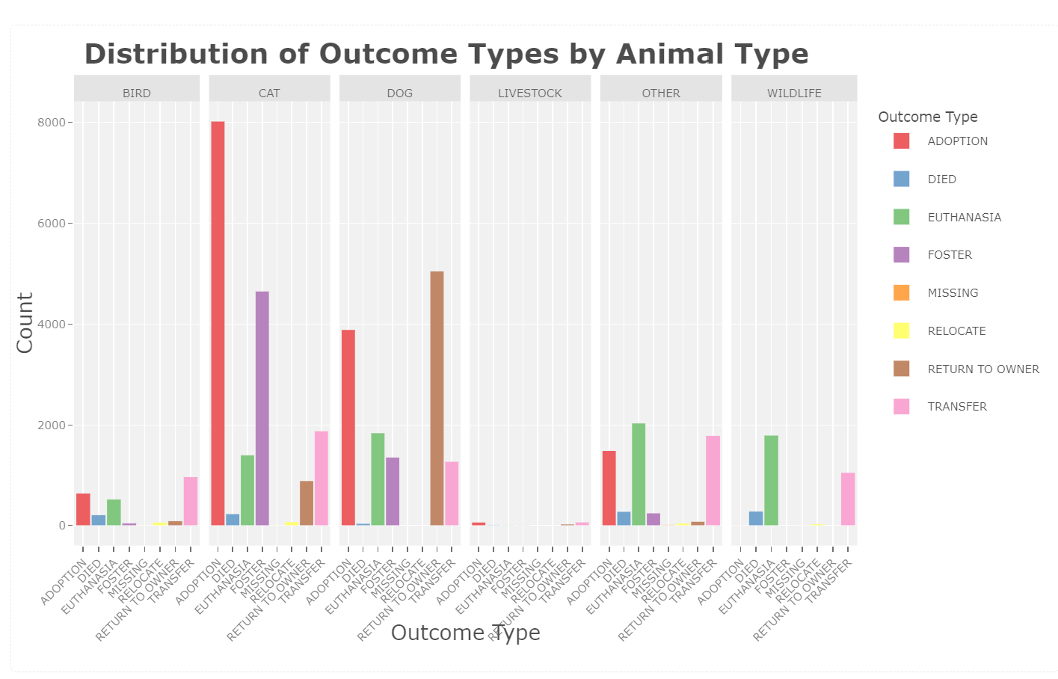

Slide 14
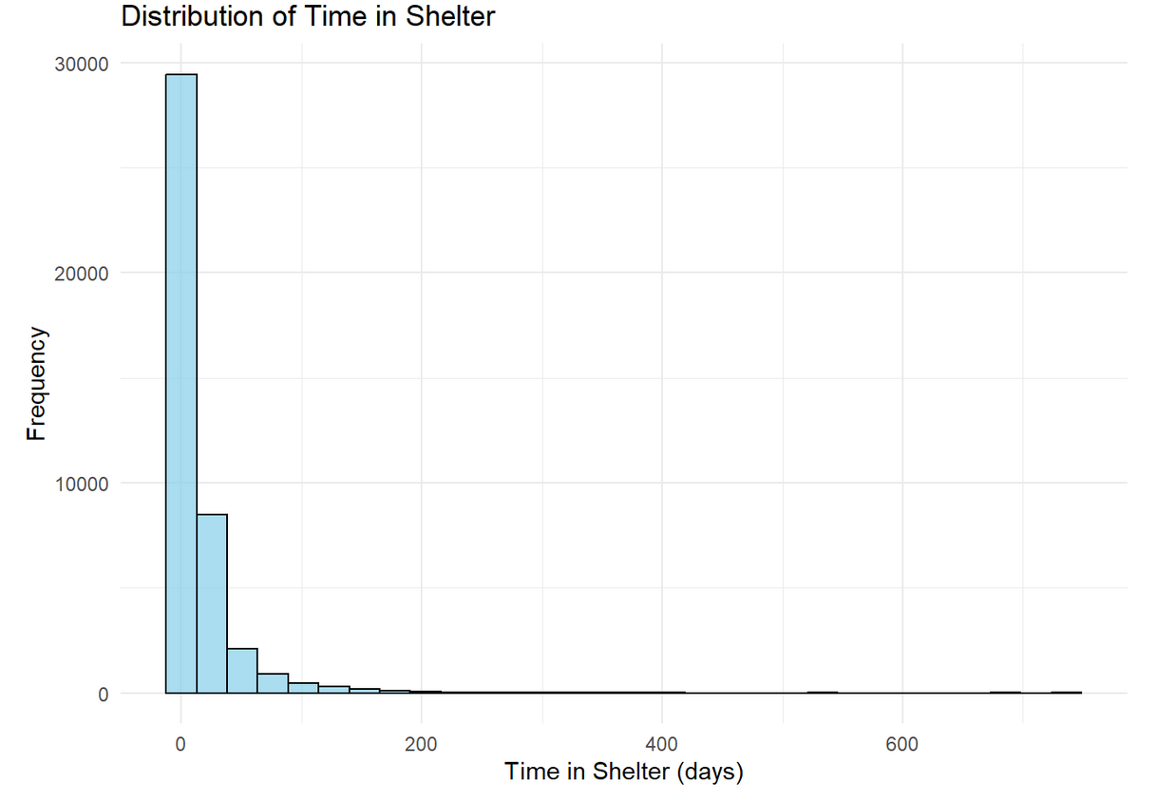
Statistical Results
The minimum time in the shelter is 0 days, the maximum is 736 days, the average (mean) time is 14.38 days, and the middle value (median) is 3 days.
Most of the animals have a very short duration in the shelter.

Slide 15
Statistical Results
Livestock tend to stay longer in the shelter.
Animals with intake types such as "Euth Req," "Foster," or "Veterinary" tend to spend less time in the shelter, while confiscated animals tend to stay longer.
Animals admitted in Spring and Summer also spend less time in the shelter compared to other seasons
There are significant differences in the time spent in the shelter between pairs of animal types.
There is a significant difference in the mean time spent in shelters between animals that are adopted and those with other outcomes. Adopted animals tend to spend more time in the shelter.
The intake type, outcome type, and animal type show a moderate correlation.

Slide 16
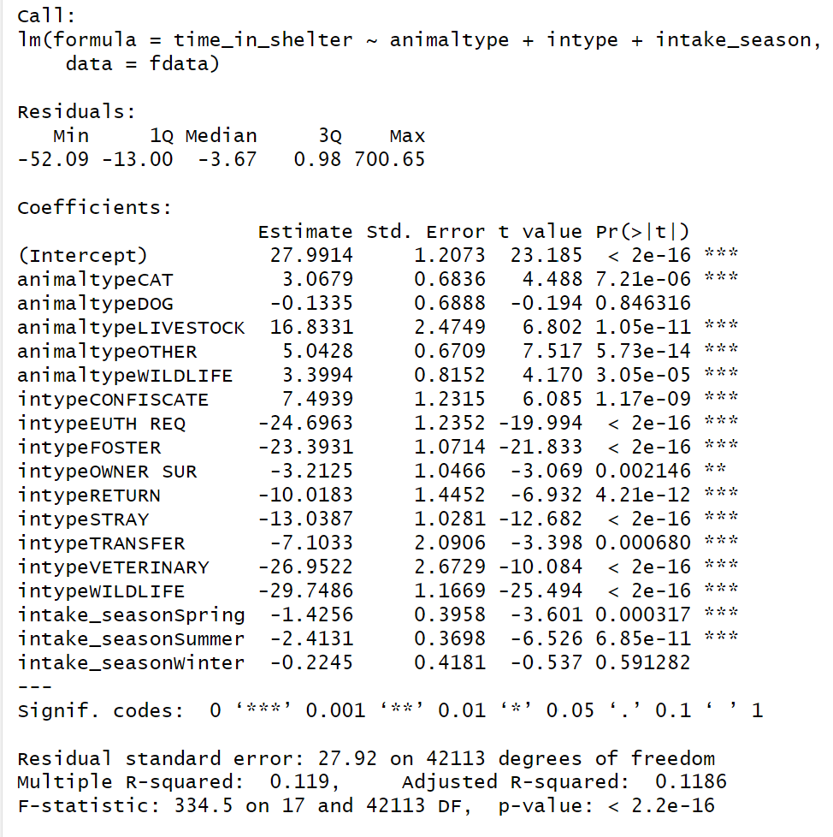
Linear regression model - predict time spent in the shelter based on animal type, intake type, and intake season
R-Squared: 0.119 (Model explains 11.9% of variance in time_in_shelter).
Statistical Significance: p < 2.2e-16.
Residual Standard Error: 27.92 (Moderate prediction variability).

Slide 17
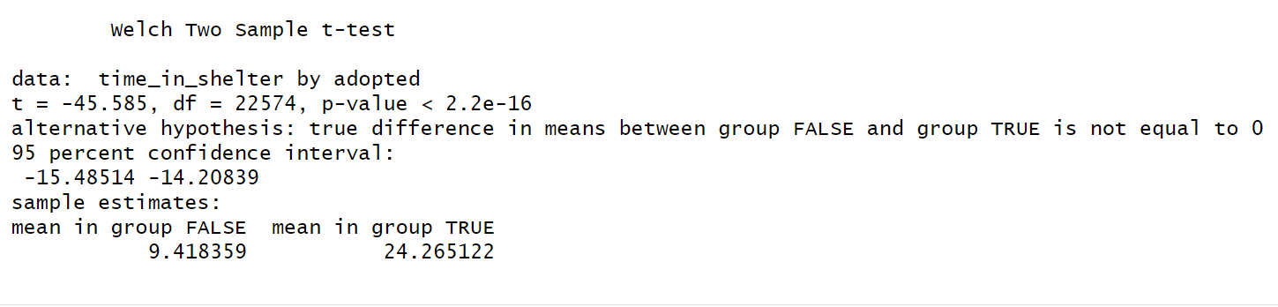
T-test – comparing Mean Time in Shelter Between Adopted and Non-Adopted Animals
t-value: -45.585, df: 22,574
p-value: < 2.2e-16 – reject null hypothesis
Conclusion: True difference in means between "Not Adopted" and "Adopted" is not equal to 0
95% Confidence Interval: [-15.48514 to -14.20839]
Sample Estimates:
Mean (Not Adopted): 9.42 days
Mean (Adopted): 24.27 days

Slide 18
Association Between Categorical Variables - Chi-Squared Tests
P-values very low (<0.05 - standard significance threshold): indicating strong evidence that the variables are correlated.
Cramér's V values around 0.3: indication moderate correlation.

Slide 19
Please refer to the detailed analysis here for further insights.
The dashboard is accessible using the following Link to the dashboard on Tableau Public.

Slide 20
References
Tableau. "Getting Started with Tableau: Drag-and-Drop Interface." Tableau Help, Tableau Software, n.d., https://help.tableau.com/current/guides/get-started-tutorial/en-us/get-started-tutorial-drag.htm.
Introduction to Tableau for Beginners." YouTube, uploaded by Data School, 15 May 2017, https://www.youtube.com/watch?v=oAIubTqg-Kw&list=PLO9LeSU_vHCU_DHaLzEvsLxFdmB3Qcao_.
How to Calculate Cramér’s V in R." GeeksforGeeks, GeeksforGeeks, n.d., https://www.geeksforgeeks.org/how-to-calculate-cramers-v-in-r/.
R Tutorial." GeeksforGeeks, GeeksforGeeks, n.d., https://www.geeksforgeeks.org/r-tutorial/?ref=outind.

Slide 21
Acknowledgments
I would like to express my sincere gratitude to my mentors, Mrs. Maria Anselmo, Mrs. Victoria Liu, Mrs. Kathy Luh, Mrs. Caroline Hairtfield, and Mrs. Victoria Lewis, for their time, availability, responsiveness, understanding, and constructive feedback. Their guidance and support have been instrumental to my understanding of the animal care field and my success in the project.
I would also like to express my deepest gratitude to my professor, Dr. Jane Valentine, for her guidance and support throughout this semester. Her insights, feedback, and encouragement have been invaluable to my learning and development, and I truly appreciate her dedication to helping me succeed.
I am also profoundly thankful to Professor Rachel Saidi for assisting me in finding my internship and offering valuable guidance with learning Tableau.

